Slide 1

Participants | Roy Shlomo Chen, Yarin Akiva
ID's: | 315998971, 318424660
Email: | Roychen651@gmail.com, Yarin3db@gmail.com
Lecturer | Nissim Barami
Practitioner | Amir Levit

Slide 2
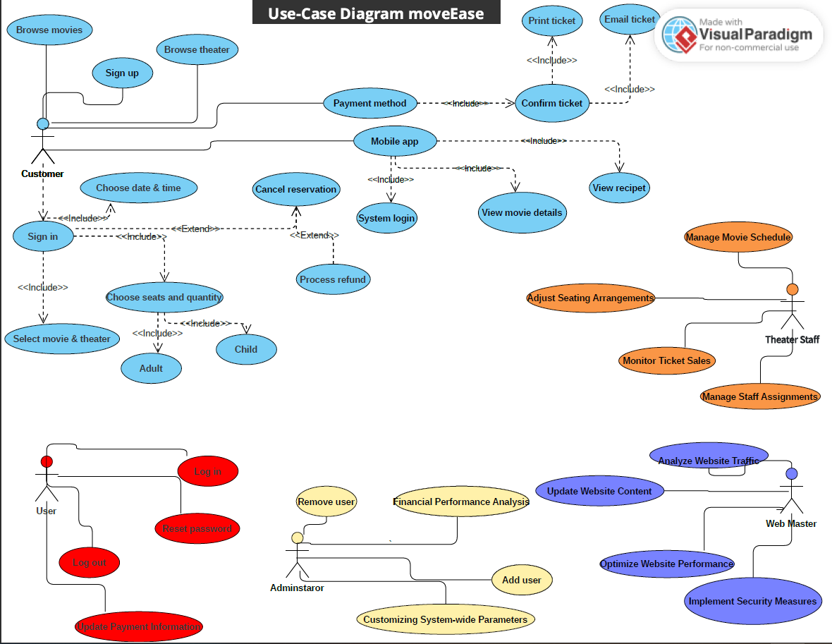

Slide 3
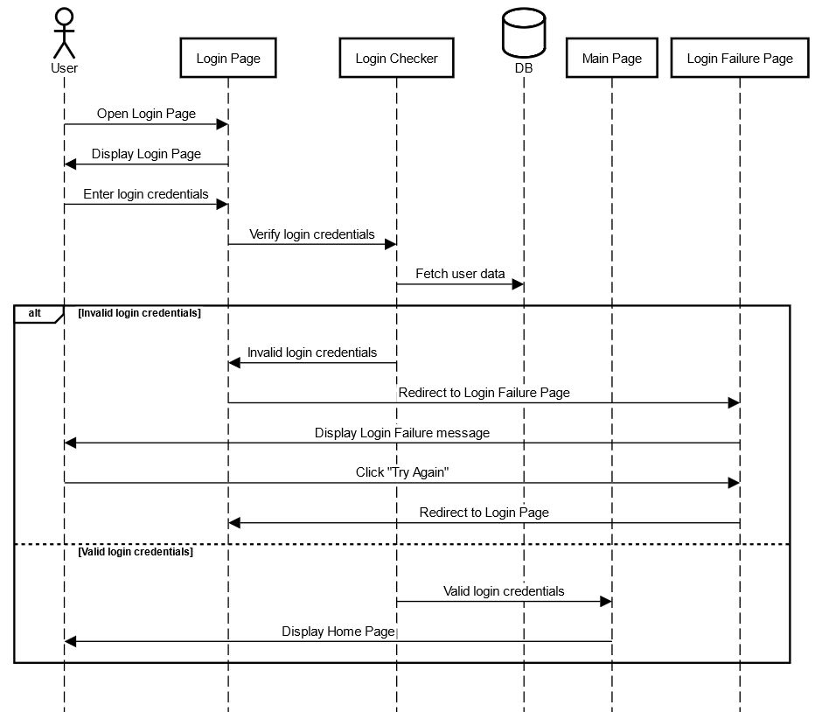
Sequence Diagram – Login

Slide 4
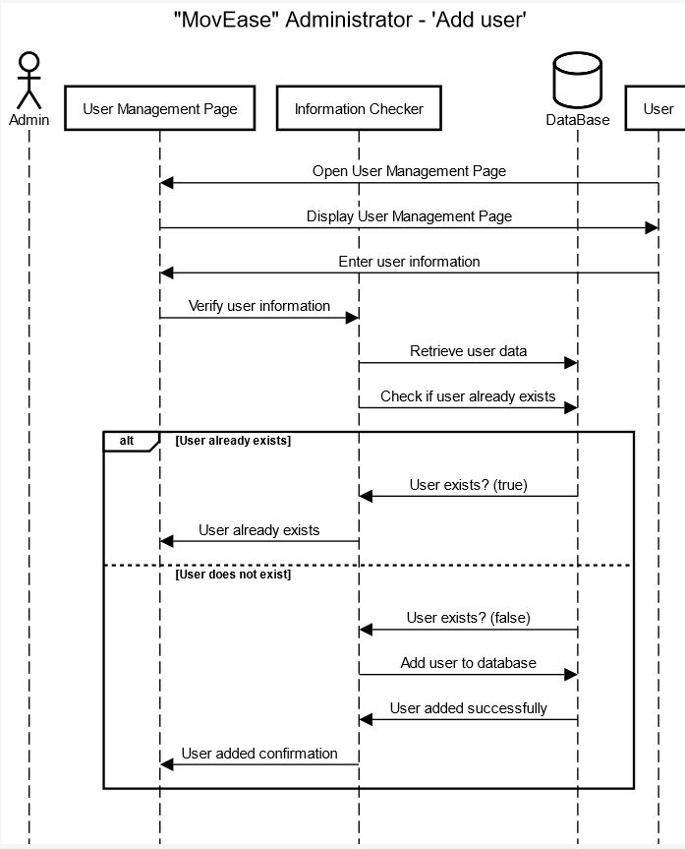
Sequence Diagram – Add User

Slide 5
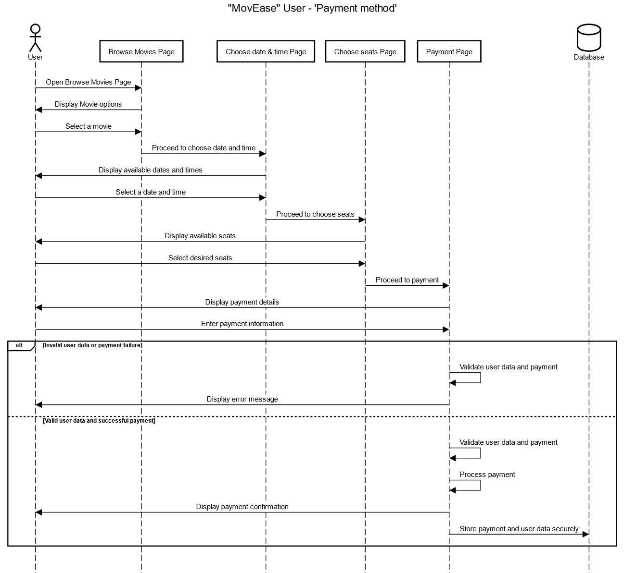
Sequence Diagram – Payment method

Slide 6
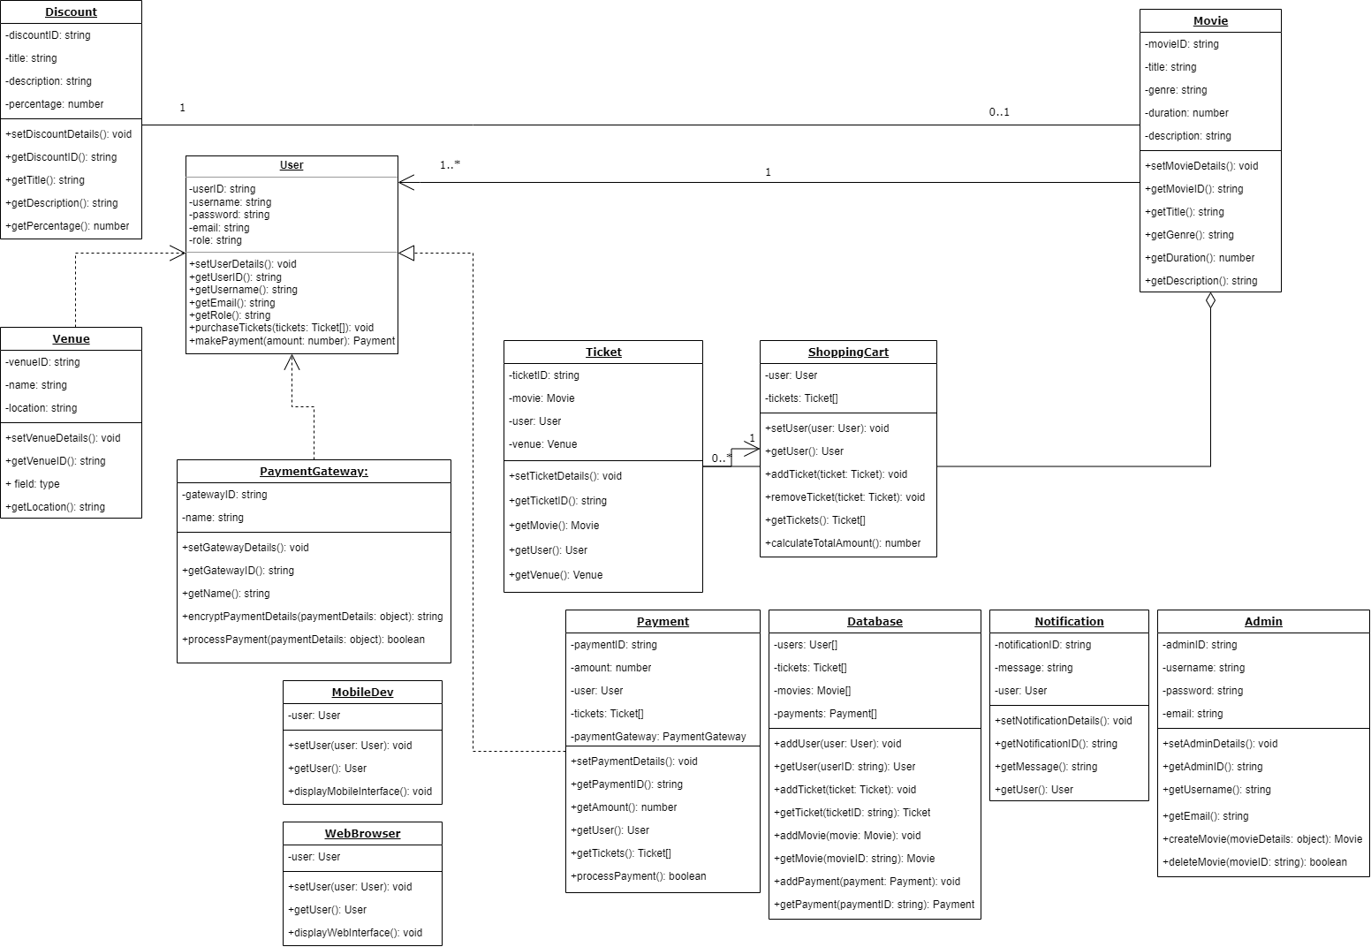
MOVEASE – Class Diagram

Slide 7
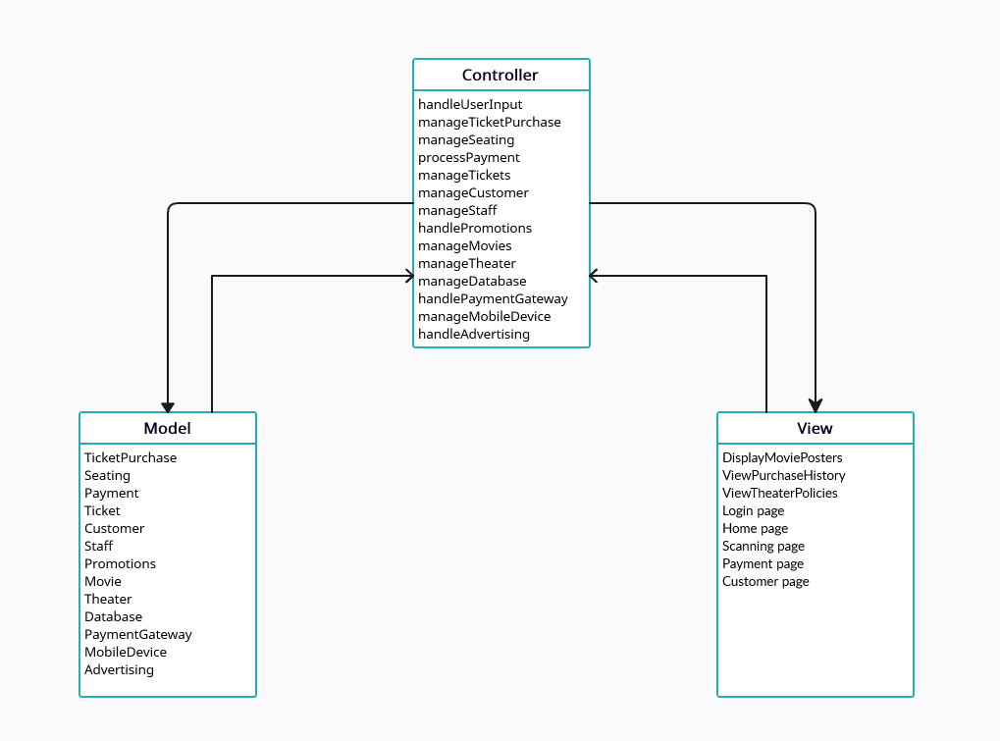
MOVEASE – MVC Diagram

